Slide 1

Higgs Boson Challenge
Presented by,
“The Gradients”
Abjasree. S
Poojan Smart
Niranjan Solanki
Vaishnav Panuganti

Slide 2
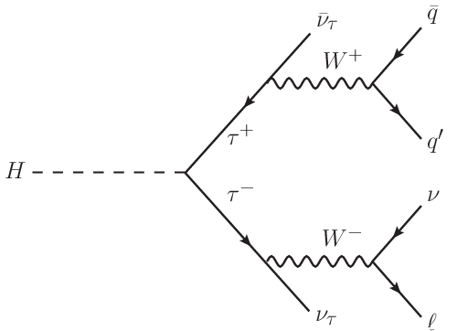

Introduction and Problem Statement
Data : Simulated data to optimize the analysis of the Higgs boson from CERN
Problem Statement : Given the data with different predictor variables classify it into signal and background
Technical details:
1. Signal: The decay of higgs bosons through tau - tau channel
2. Background: Other channels and uninteresting events
Goal : Improve the procedure that produces the selection region/improve the recall or TPR along with reducing FPR
Objective: maximize Absolute Median Significance (AMS)

Slide 3
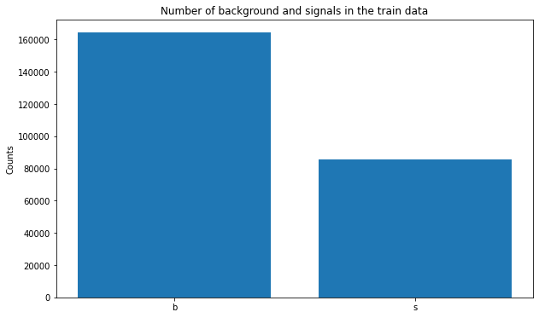
Data Preprocessing and EDA
All the values that are undefined (-999) in the data set as been replaced by the median of the respective columns and several cut off were implemented as given in the documentation^{[1]}
The signal has been encoded as 1 and the background 0
We have scaled the variables using Standardscaler()
The Weight and EventId has been dropped as suggested in the documentation given^{[1]}
The first observation from the EDA is that the data set is unbalanced
^{[1]} https://higgsml.lal.in2p3.fr/files/2014/04/documentation_v1.8.pdf

Slide 4
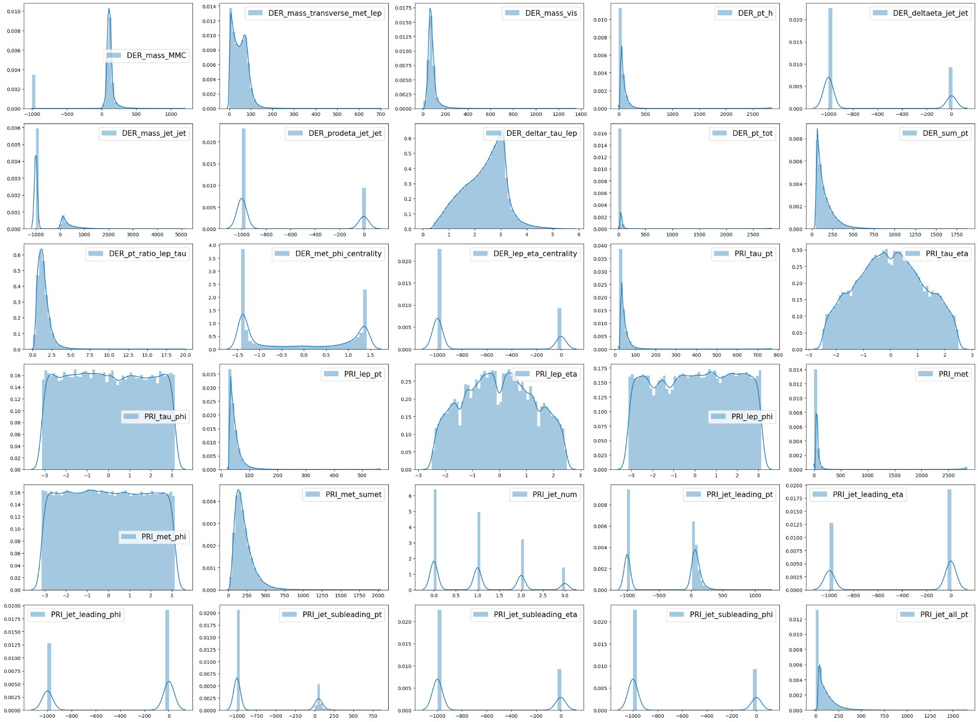
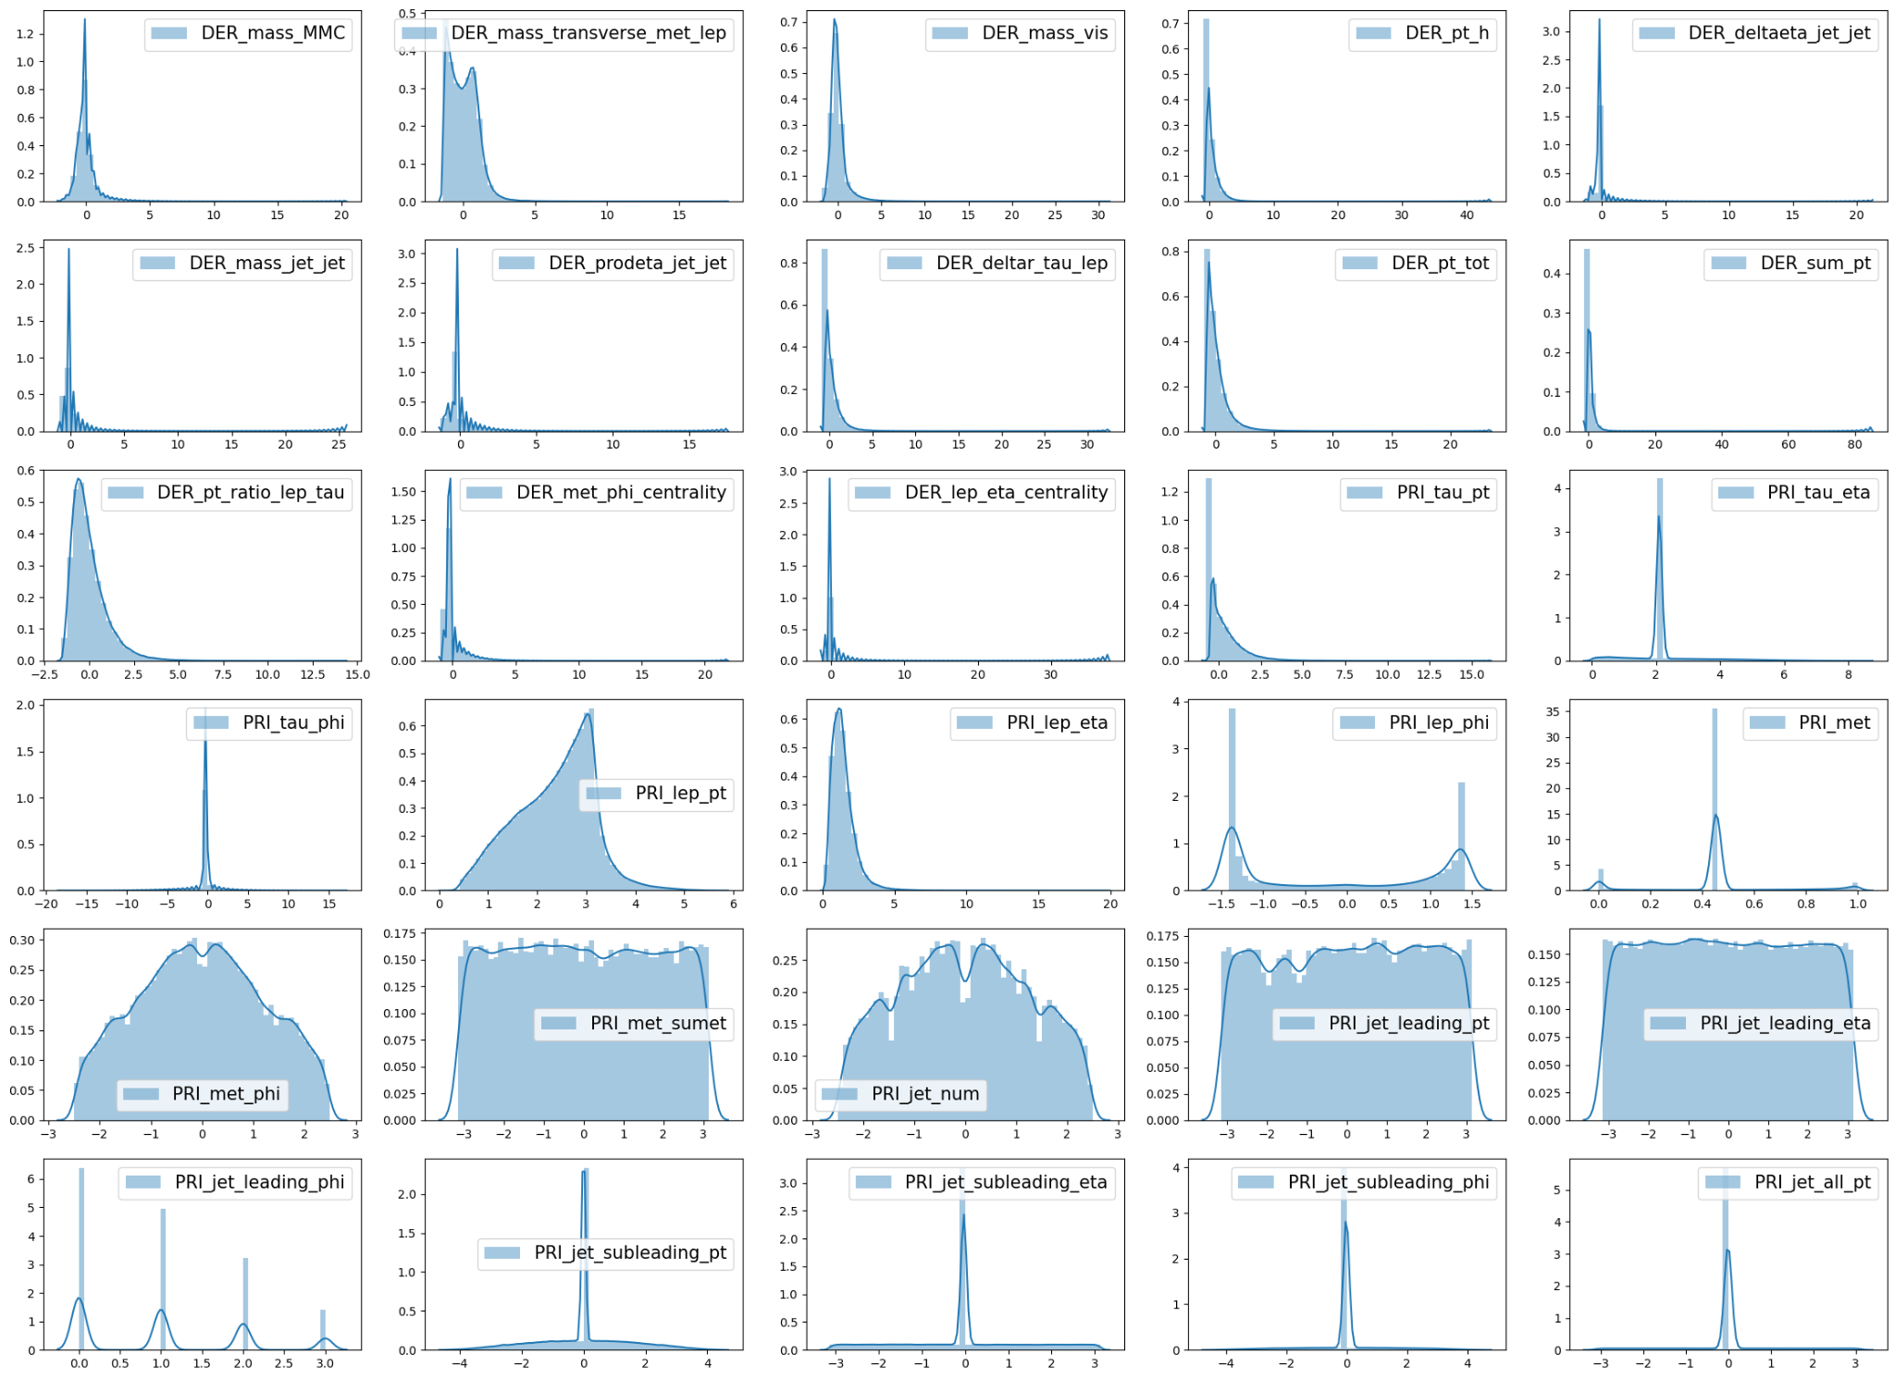
Exploratory Data Analysis
Before Preprocessing
After Preprocessing

Slide 5
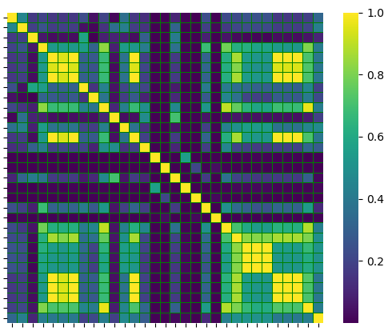
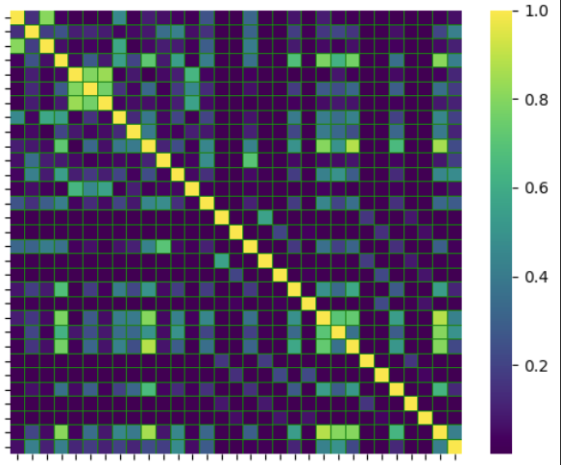
Correlation Matrix
Before Preprocessing
After Preprocessing
After preprocessing, the correlation is reduced

Slide 6
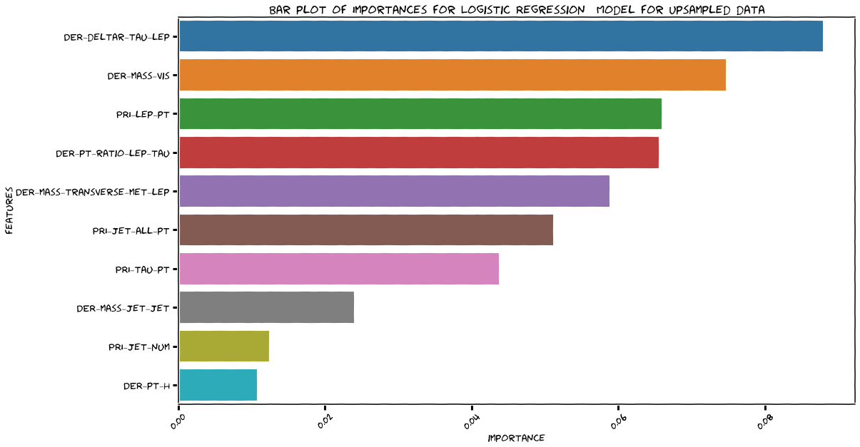
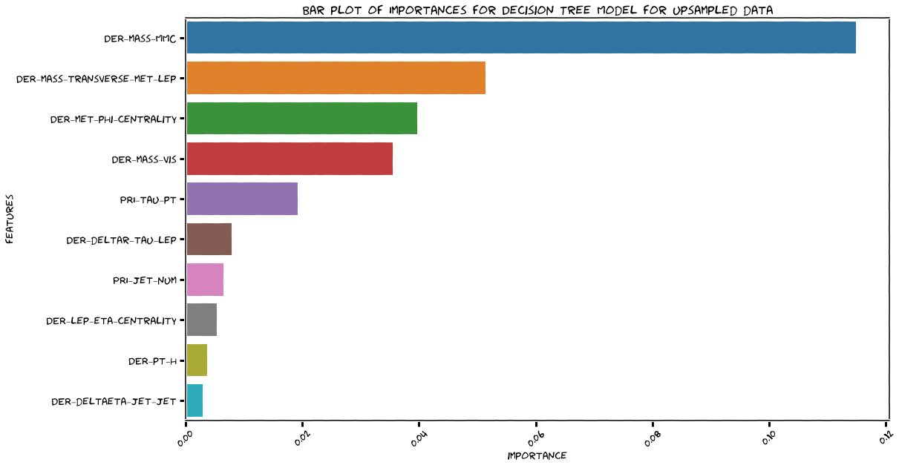
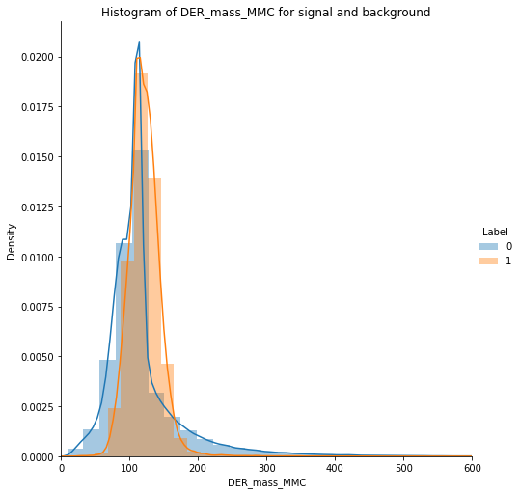
Feature Importance obtained from Logistic Regression and Decision Trees (Base Models)
The features which are important for logistic regression and the decision trees are different
The feature importance is calculated using the permutation importance

Slide 7
Base Models:
Approach 1: Improving Recall
Hyperparameters are tuned using GridSearchCV
All the evaluation metrics are calculated from the validation data which we got from train_test_split
+-----------------------------------------------+--------+----------+-----------+--------+
| Strategy | Recall | F1 Score | AUC score | AMS |
+-----------------------------------------------+--------+----------+-----------+--------+
| Logistic Regression - No imbalance correction | 0.5333 | 0.5946 | 0.6983 | 0.8745 |
| Logistic Regression - Upsampling | 0.7624 | 0.6668 | 0.7437 | 0.8852 |
| Logistic Regression - Downsampling | 0.7702 | 0.6685 | 0.745 | 0.8901 |
+-----------------------------------------------+--------+----------+-----------+--------+
+-----------------------------------------+--------+----------+-----------+--------+
| Strategy | Recall | F1 Score | AUC score | AMS |
+-----------------------------------------+--------+----------+-----------+--------+
| Decision Tree - No imbalance correction | 0.7045 | 0.732 | 0.7944 | 1.1556 |
| Decision Tree - Upsampling | 0.8025 | 0.7418 | 0.8066 | 1.0252 |
| Decision Tree - Downsampling | 0.8154 | 0.7417 | 0.8072 | 1.0072 |
+-----------------------------------------+--------+----------+-----------+--------+

Slide 8
Base Models:
Approach 2 : Improving F1 Score
+-----------------------------------------------+--------+----------+-----------+--------+
| Strategy | Recall | F1 Score | AUC score | AMS |
+-----------------------------------------------+--------+----------+-----------+--------+
| Logistic Regression - No imbalance correction | 0.5333 | 0.5946 | 0.6983 | 0.8745 |
| Logistic Regression - Upsampling | 0.7642 | 0.6676 | 0.7444 | 0.8875 |
| Logistic Regression - Downsampling | 0.7702 | 0.6685 | 0.745 | 0.8901 |
+-----------------------------------------------+--------+----------+-----------+--------+
+-----------------------------------------+--------+----------+-----------+--------+
| Strategy | Recall | F1 Score | AUC score | AMS |
+-----------------------------------------+--------+----------+-----------+--------+
| Decision Tree - No imbalance correction | 0.7033 | 0.7316 | 0.7941 | 1.1572 |
| Decision Tree - Upsampling | 0.8003 | 0.7426 | 0.807 | 1.0342 |
| Decision Tree - Downsampling | 0.8076 | 0.7405 | 0.8058 | 1.0181 |
+-----------------------------------------+--------+----------+-----------+--------+

Slide 9
Ensemble Models: Bagging and Gradient Boosting
+-----------------------------------+--------+----------+-----------+--------+
| Strategy | Recall | F1 Score | AUC score | AMS |
+-----------------------------------+--------+----------+-----------+--------+
| Bagging - No imbalance correction | 0.7098 | 0.7449 | 0.8035 | 1.2319 |
| Bagging Tree - Upsampling | 0.8155 | 0.7534 | 0.8161 | 1.0661 |
| Bagging Tree - Downsampling | 0.8214 | 0.756 | 0.8185 | 1.0733 |
+-----------------------------------+--------+----------+-----------+--------+
+---------------------------------------------+--------+----------+-----------+--------+
| Strategy | Recall | F1 Score | AUC score | AMS |
+---------------------------------------------+--------+----------+-----------+--------+
| Gradient Boosting - No imbalance correction | 0.71 | 0.7471 | 0.805 | 1.2347 |
| Gradient Boosting - Upsampling | 0.8078 | 0.7579 | 0.819 | 1.0886 |
| Gradient Boosting - Downsampling | 0.8209 | 0.7585 | 0.8204 | 1.0768 |
+---------------------------------------------+--------+----------+-----------+--------+

Slide 10
Ensemble Models: Random Forest
Improving Recall
+-----------------------------------------+--------+----------+-----------+--------+
| Strategy | Recall | F1 Score | AUC score | AMS |
+-----------------------------------------+--------+----------+-----------+--------+
| Random Forest - No imbalance correction | 0.7089 | 0.7504 | 0.8071 | 1.2851 |
| Random Forest - Upsampling | 0.8051 | 0.7659 | 0.8246 | 1.14 |
| Random Forest - Downsampling | 0.8239 | 0.7589 | 0.8209 | 1.0916 |
+-----------------------------------------+--------+----------+-----------+--------+
Improving F1 Score
+-----------------------------------------+--------+----------+-----------+--------+
| Strategy | Recall | F1 Score | AUC score | AMS |
+-----------------------------------------+--------+----------+-----------+--------+
| Random Forest - No imbalance correction | 0.7097 | 0.7513 | 0.8078 | 1.2927 |
| Random Forest - Upsampling | 0.8051 | 0.7659 | 0.8246 | 1.14 |
| Random Forest - Downsampling | 0.8051 | 0.7659 | 0.8246 | 1.14 |
+-----------------------------------------+--------+----------+-----------+--------+

Slide 11
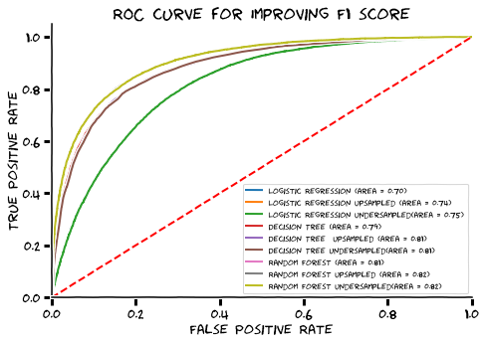
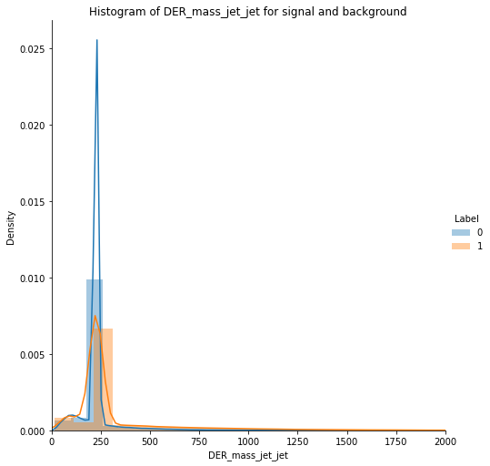
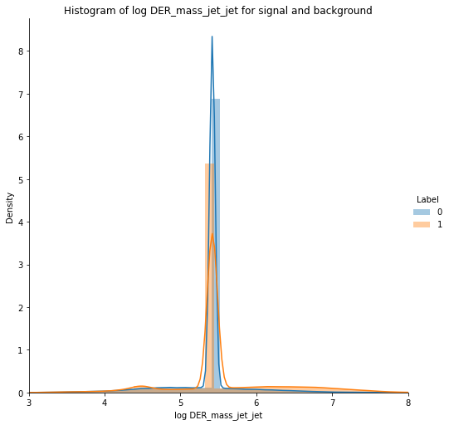
Inference and Conclusion
Up/Down sampling gave better accuracy, recall, f1 but AMS went down for decision tree based models. For Logistic regression it slightly improved AMS.
Tuning hyperparameters using F1 score did not provide any significant benefit.
Random Forest model tuned using F1 score gives slightly more AMS compared to other ensemble models
Feature Importance: Derived columns seems to be more important compare to Primary columns.
IMPROVEMENTS
Feature Engineering: Log transform.
Better estimation for AMS. (Bootstrap)
Better way to incorporate invalid values.

